Slide 1
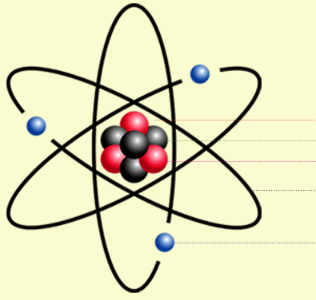
Daily Review
Describing the Structure of an Atom
State the number of protons and neutrons in the nucleus. State the number of electrons orbiting the nucleus. State whether the atom is neutral or charged. neutral = number of protons and electrons is equal charged = number of protons and electrons is not equal
Describe the structure of the beryllium atom.
Proton
There are ___ protons and ___ neutrons in the nucleus.
There are ___ electrons orbiting the nucleus.
The atom is ________ because __________.
Neutron
Electron

Slide 2
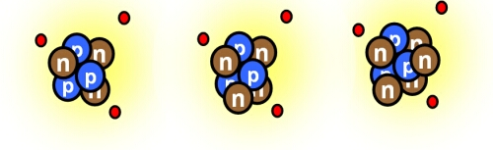
Daily Review
CFU 1
What is the atomic mass of each of these lithium atoms?
Atomic Mass
The mass of an atom is found by adding the number of protons and neutrons.
Different isotopes are written with their atomic mass after the element name, for example helium-4 or helium-5.
CFU 2
Write the name of each lithium isotope.

Slide 3
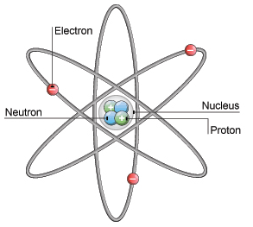
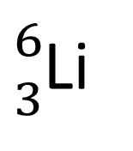
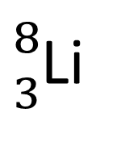
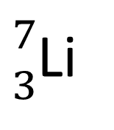
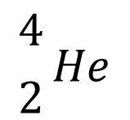
Daily Review
$${4 \atop 2}He$$
Atomic Symbols
An atomic symbol always includes:
The symbol of the element
The atomic number (in front of and below the element symbol)
The atomic mass (in front of and above the element symbol)
Write the atomic symbols for the three lithium isotopes.
${6 \atop 3}$Li
${7 \atop 3}$Li
${8 \atop 3}$Li

Slide 4
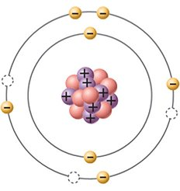
Daily Review
CFU 1
How many electrons can the third shell hold?
Electron Shells
Electrons occupy specific areas of space around the nucleus, called electron shells.
Each shell can only hold a limited number of electrons.
The first shell holds up to 2 electrons
The second shell holds up to 8 electrons
The third shell holds up to 18 electrons
The arrangement of electrons in an atom is called its electron configuration.
CFU 2
In the atom shown, how many more electrons could fit in the second electron shell?

Slide 5
Daily Review
CFU 1
Draw an atom that has 6 electrons in its shells.
Filling Electron Shells
The first 2 electrons go in the first shell, one on each side.
The next 4 electrons go in the second shell, starting at the top and moving clockwise.
The next 4 electrons go in the second shell, and form pairs with the other electrons.
The third shell fills in the same way as the second.
CFU 2
Draw an atom that has 9 electrons in its shells.
Nucleus

Slide 6
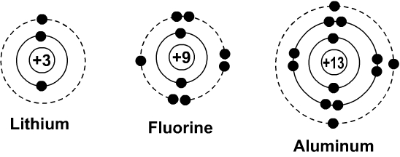
Daily Review
CFU 1
Write the electron configuration for the lithium, fluorine and aluminium atoms.
Electron Configuration
Represents the arrangement of electrons using numbers.
The number of electrons is listed in order from the innermost shell to the outermost shell, separated by commas.
For example, the electrons in the nitrogen atom can be shown as: 2, 5

Slide 7
Energy of Electrons and Flame Tests

Slide 8

Learning Objectives
CFU
What are we going to learn?
Explain why coloured light is emitted by some metals when heated.
Conduct flame tests to observe colours emitted by different elements.
Activate Prior Knowledge
Elements can be classified as metallic elements or non-metallic elements.
Think, pair, share: Which of these elements are metals and which are non-metals?
Iron Chlorine Helium Copper Carbon Zinc Gold
Think, pair, share: What are some things that these metals have in common?

Slide 9
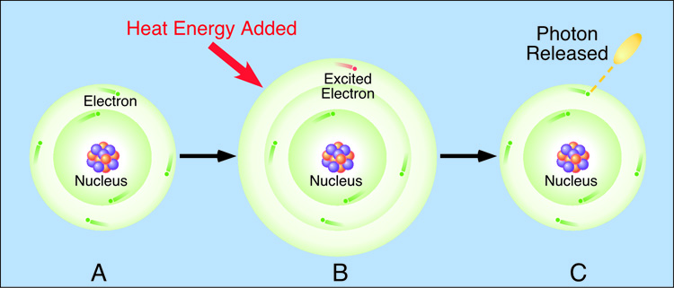
Concept Development
CFU 1
Which electrons are able to jump shells?
Excited Electrons
In an atom, the electrons orbit the nucleus in particular spaces, called electron shell.
When energy (often thermal or electrical) is added to the atom, the electrons in the outermost shell can jump to a shell further away from the nucleus.
When an electron has jumped to a higher electron shell, it is called an excited electron.
CFU 2
What causes and electron to jump to a higher shell?
CFU 3
What term is used to describe electrons that have jumped to another shell?

Slide 10
Concept Development
CFU 1
What happens when electrons return to their original shell?
Excited Electrons
Excited electrons cannot stay in the higher shell, so they drop back to their original shell.
When they do this, light (photons) is emitted.

Slide 11
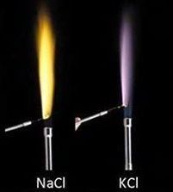
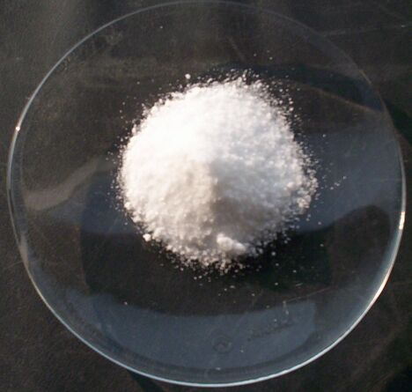
Concept Development
CFU 1
What happens when electrons return to their original shell?
Colours of Light Emitted
The colour of light emitted changes depending on the element and can be used to identify different elements.
For example, compounds containing sodium will produce a yellow colour, whereas potassium produces a pale purple.
CFU 2
How is the colour of light emitted useful to a scientist?
CFU 3
Think, pair, share: Potassium chloride and sodium chloride are both white solids. How could you tell the difference between the two?

Slide 12
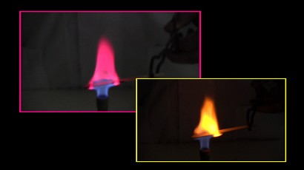
Skill Development/Guided Practice
You are going to conduct an experiment to observe the colours emitted by different metallic elements.
You will hold a pop stick soaked in a solution of a compound containing the element in a Bunsen burner flame and record how the colour of the flame changes.
You will need to wear safety glasses while using the Bunsen burner

Slide 13

Relevance
The colours emitted by different compounds can be used to help identify the metallic element in the compound.
Each element emits a unique combination of colours, which can be analysed to determine the element. Some colours emitted by different elements are shown in the picture.

Slide 14
Independent Practice
Collect a copy of the flame test experiment and conduct the tests as instructed by your teacher.
Complete the follow-up questions on the back of the sheet.

